Slide 1
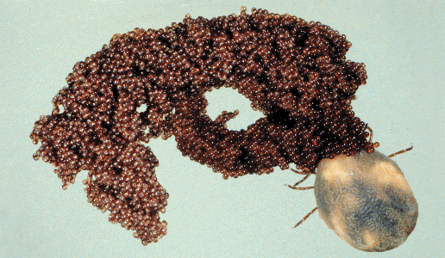
Modeling a Lone Star Tick (Amblyomma americanum) population for effective disease management
Crystal Bennett
NC A&T State University
http://www.ag.auburn.edu/aaes/communications/highlights/fall00/images/tickone.gif
Laura Bahorich, Zoey Benally, Crystal Bennett & James Nance
Mentors: Graham Hickling, PhD, Suzanne Lenhart, PhD,
Notes:
Would like to acknowledge the other collaborators on this project…
As you may recall from our midterm presentation….
The ticks we studied for this project are Amblyomma americanum, Lone Star Ticks.
This tick is a vector for HME / Human Monocytic Ehrlichiosis, an infectious disease transmitted by ticks in Tennessee.
This disease is caused by the rickettsia, Ehrlichia chaffeensis
The primary host for these ticks is the White Tail Deer.
We are concentrating on FFG community
In 1993 there was an Ehrlichiosis outbreak in FFG
Female tick that has just deposited 5000 eggs. The female tick will die after laying eggs.

Slide 2
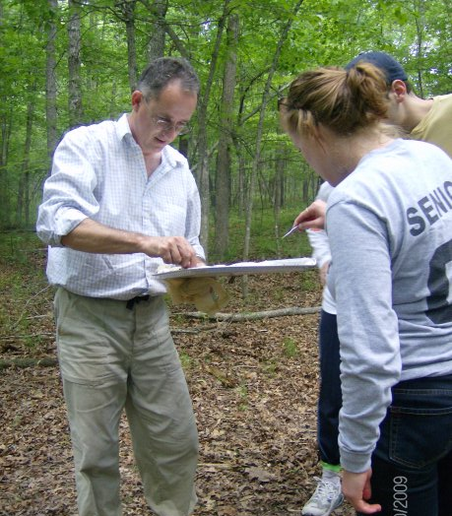
Outline
Goals
Background
Methods
Model
Conclusion
Notes:
We going to talk about…
Goals, Tick, disease,

Slide 3
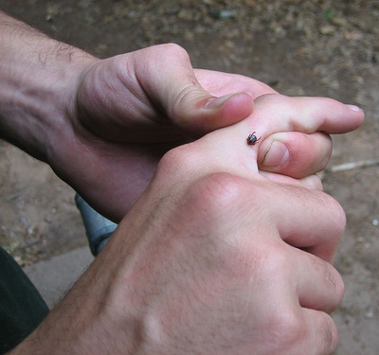
What’s the Problem?
Lone Star Ticks are the most common tick species in TN
Aggressive – actively seek out & bite hosts
All life stages can transmit diseases to humans
http://farm1.static.flickr.com/78/197572898_ddccb25d15.jpg?v=0
Notes:
LST tick is…
…our group had first hand experience with aggressive ticks when we were bombarded by ticks at FFG.

Slide 4
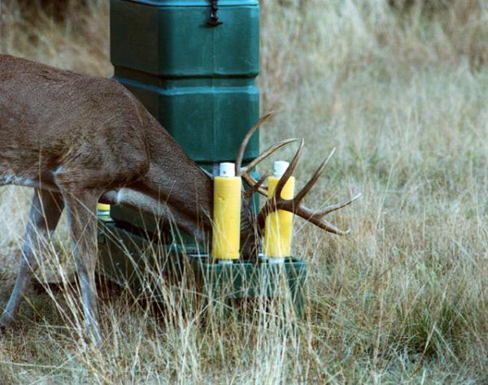
Goals
To model the lifecycle of the Lone Star Tick within the Fairfield Glade (FFG) retirement community
To determine a cost-effective layout of 4-poster feeders to reduce disease caused by Lone Star Ticks
http://www.sciencedaily.com/releases/2009/03/090328152625.htm
Notes:
Our goals are to…
Temporal – Discrete time model of ticks in FFG
Spatial-Temporal – Model for cost-effective 4-poster arrangement
AIM: Choose feeder layout to minimize the expected total cost of disease cases plus the feeder program
Ehrlichia Treatment = $10,000/case
Feeder Maintenance = $2,000/year
Example: if 12 feeders reduced ticks by 40% then:
(Base number of cases is 10 per year)
TOTAL COST = (6 cases x $10,000) + (12 feeders x $2000)
= $60,000 disease + $24,000 feeders
= $84,000

Slide 5
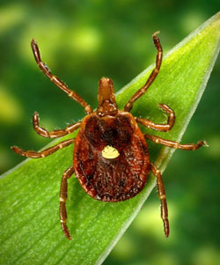
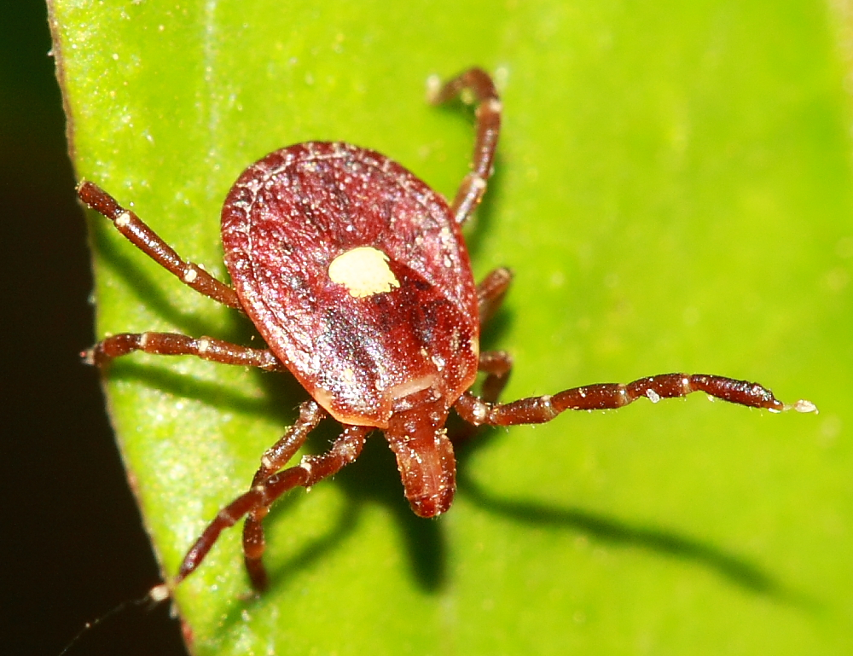
Background
Lone Star Ticks vector disease
10 pathogens isolated, Ehrlichia chaffeensis is the most important
White-Tailed Deer are the ticks’ natural host
Egg →Larva → Nymph → Adult →Egg
3 blood meals during life cycle, usually on deer
Spend 95% of time off host
http://www.umass.edu/umhome/images/upload/83388/tularemia_lone_star_tick-sm.jpg
Notes:
Some key features are…
Ticks are abundant
Deer is the natural, preferred host of all three tick stages
The deer remain bacteremic, i.e., bacteria is circulating in their blood
21 days???
Ticks can also carry RMSF, but there are other more important vectors for RMSF
Ehrlichiosis is an emerging disease
Red arrows represent the 3 blood meals…
Require blood meal to go from larva to nymph to adult and to lay eggs
Only feed on host for about a week.

Slide 6
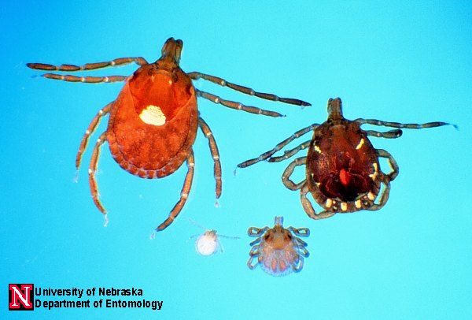
Background
http://entomology.unl.edu/images/ticks/lonestar_stages.jpg

Slide 7
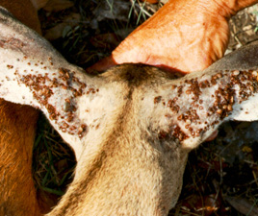
Deer Infested by Ticks
http://deeralliance.com/FCKeditor/UserFiles/Image/Tick%20Deer%20ears%20.jpg
Notes:
Illustrates the magnitude of ticks that can be found on WTD
Ticks prefer attaching on the deer ears and neck.
Catoosa WMA, Cumberland and Morgan counties, 80,000 acres
Increasing deer population & decreasing hunting.

Slide 8
4-Poster System
Management strategy targets ticks on deer
Bait feeder plus acaricide
Systemic vs. topical
7 - 9 feeders in use at FFG
Cost is ~$16,000 annually
Feeders have achieved close to 100% reduction in tick numbers at other locations
Tick numbers remain high around FFG feeders
http://www.sciencedaily.com/releases/2009/03/090328152625.htm
Notes:
Average of 300 ticks per deer
Preferred blood meal of all 3 tick stages
Successful Lone Star Tick management includes aspects of tick control on deer
Hunting NOT an option at Fairfield Glade
Developed by the USDA.
Whole kernel corn attracts the deer to the feeder.
Paint rollers impregnated with acaricide (permethrin & amitraz).
Deer head, ears & neck contact acaricide.
Although systemic treatment (such as Ivermectin) has shown to also be effective, FDA regulations require a 49 day withdrawal period before slaughter (hunting season).
FFG community policy doesn’t allow feeders to be placed 100 yards from unsupervised children.
4-Posters have shown significant reduction in tick numbers, but tick numbers remain high around FFG feeders.
Suspect that the feeder have decreased effectiveness due to insufficient maintenance, malfunction, etc.
Also the tests were conducted on deer in fenced pens.
$14,000 for 7 feeders at FFG

Slide 9
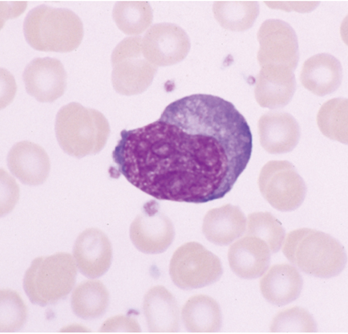
Ehrlichiosis
Ehrlichia chaffeensis – Human monocytic ehrlichiosis (HME)
Bacteria enter blood when tick feeds
Symptoms – fever, malaise, leukopenia, thrombocytopenia
Median age 55
Disease we’re focusing on…
Actually w/in WBCs. Bacteria enters host blood when the tick is feeding.
Explain WBCs
Older & immuno-compromised have fewer WBC, therefore see a more severe disease in the end.
Very generic symptoms.
Antibiotics are used to manage the disease.
More prevalent in older populations. More important in Fairfield Glade because a majority of the residents are w/in age group.
http://www.nature.com/modpathol/journal/v17/n5/thumbs/3800075f1th.jpg

Slide 10
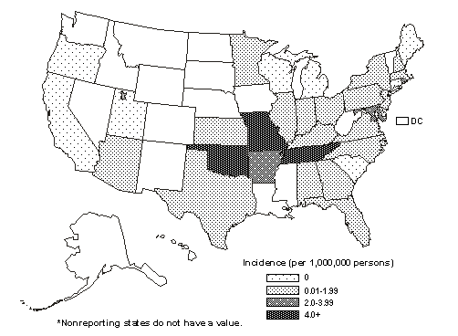
Average annual incidence of Ehrlichiosis (caused by Ehrlichia chaffeensis) by state, 2001--2002
http://www.cdc.gov/ticks/diseases/ehrlichiosis/statistics.html
Notes:
TN is one of 3 highest states in US. Hot spot.

Slide 11
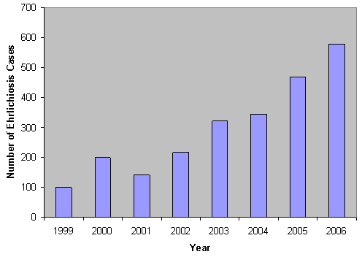
Number of Ehrlichiosis cases in US
(caused by Ehrlichia chaffeensis), 1999-2006
http://www.cdc.gov/ticks/diseases/ehrlichiosis/statistics.html
Notes:
Emerging disease
First case was not described until 1987
The number of Ehrliciosis cases have been increasing ever since
Could be underreported. Difficult to diagnose.
The worst outbreak in US was in 1993 in FFG

Slide 12
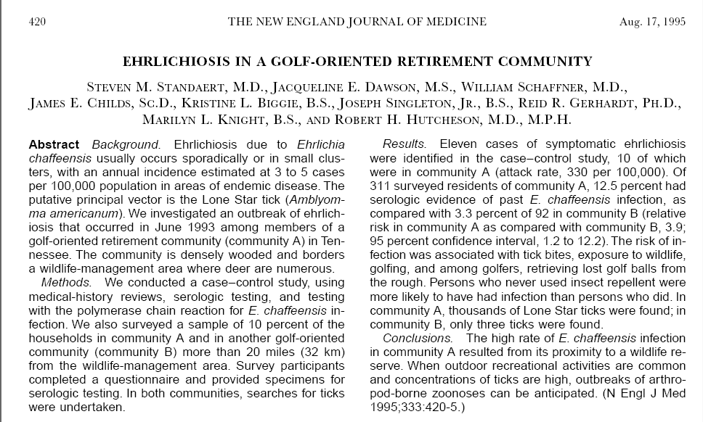
Notes:
Standaert SM, Dawson JE, Schaffner W, Childs JE, Biggie KL, Singleton J, Gerhardt RR, Knight ML, Hutcheson RH (1995). Ehrlichiosis in a Golf Oriented Retirement Community. New England Journal of Medicine; 333: 420-5.

Slide 13
Fairfield Glade Outbreak

Slide 14
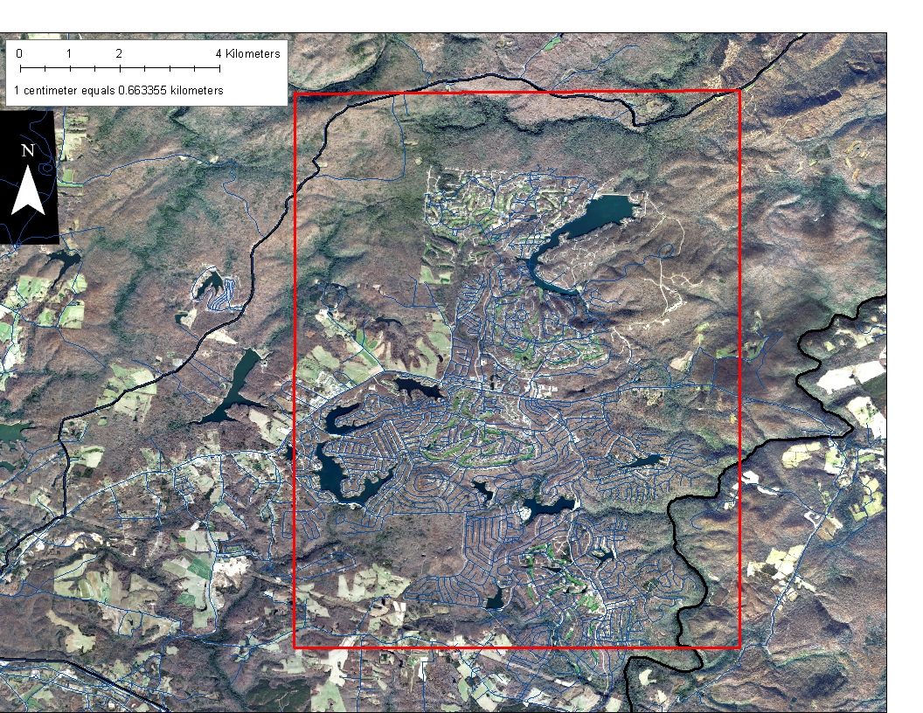

Catoosa WMA
Fairfield Glade
Crossville
Notes:
FFG is a community of approximately 6000 people, located north of Crossville and I-40.
The community is bounded by the 80,000 acre Catoosa Wildlife Management area on the north.
Carved out of woods.
Put elderly golfers in tick habitat.
Predominantly elderly residents.
Attack rates were 100 times higher than the national average.
Study published in New England Journal of Medicine.
Hit ball off fairway & go into woods to retrieve ball

Slide 15
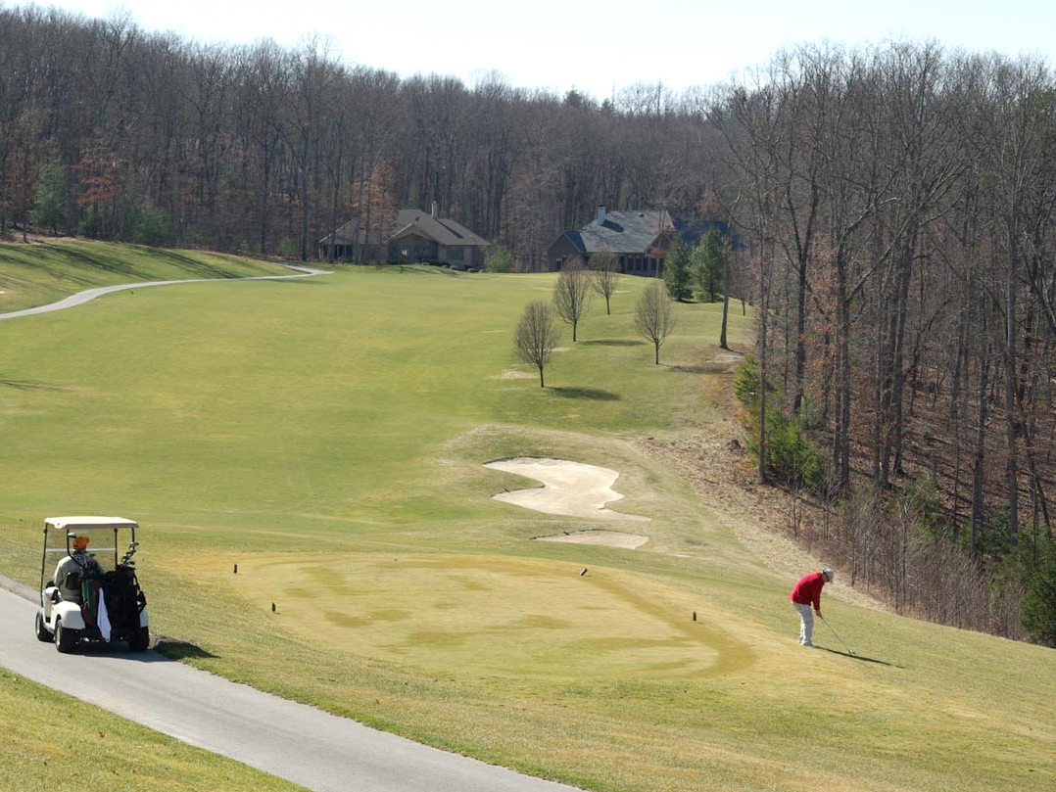
Notes:
15,000 acre golf-oriented retirement community
Fenceless northern border with 80,000 acre wildlife management area
3000 permanent residents
National average, 3 to 5 cases per 100,000
FFG, 330 cases per 100,000
3.7 increased risk if retrieve ball from rough

Slide 16
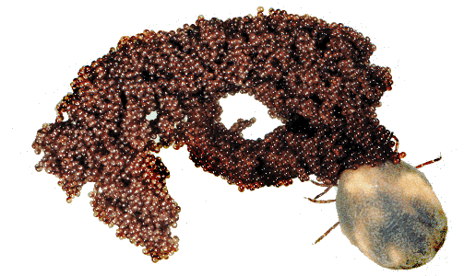
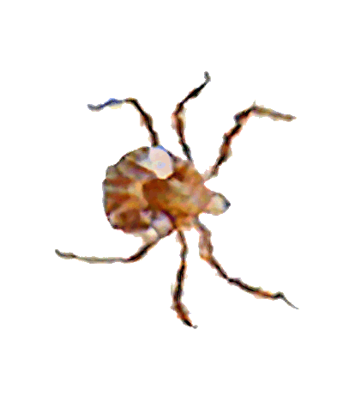

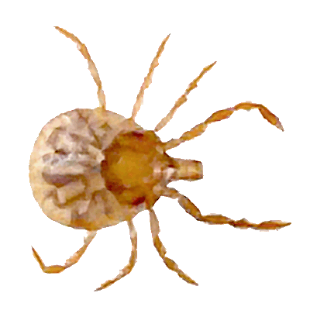
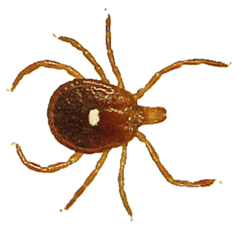

Spring
Winter
Summer
Fall

Slide 17
Monthly Lone Star Tick Rates
Notes:
FFG Data – collected by Graham Hickling & students.
Represents questing stages collected in the field. Unfed Questing stages will be collected.
Shows a seasonal shift
Eggs are laid in the spring by fed adults.
The eggs hatch into unfed larva.
The larva finds the first host, takes a blood meal & is then a fed larva.
The larva molts by late summer into an unfed nymph.
The unfed nymph overwinters in the leaf litter and re-emerges in spring.
The nymph finds the second host, takes a blood meal & is then a fed nymph.
The nymph molts into an unfed adult.
The unfed adult overwinters in the leaf litter and re-emerges in spring.
The adult tick finds the third host, takes a blood meal, mates, lays eggs and dies.

Slide 18
Methods
Discrete Time Model of A. americanum in FFG
Based on 7 life stages
Using MATLAB to run a simulation model for 4 years
Monthly time step begins in April
Overwintering of unfed nymphs & unfed adults
Eggs laid by overwintering fed adult population
Compare to field data collected at FFG
Notes:
Say that adults die after the eggs are laid.
No disease in model
Disease risk is assumed to be correlated with tick numbers
Monthly time step starts in April

Slide 19
Model Coefficients and Rates
Obtained from Haile and Mount (1987) “Computer Simulation of Population Dynamics of the Lone Star Tick, Amblyomma americanum” – some were adjusted to fit the Fairfield Glade data.
Mortality and host-finding rates based on temperature and humidity
Sex ratio of 1:1
Females lay 5,000 eggs
Notes:
Came from article by Haile & Mount called…
Average temperature & humidity for FFG…
Assumed…

Slide 20
Temporal Component of Model
Assumptions:
  Eggs, unfed adults, and unfed nymphs start each year
  52% of laid eggs hatch in 2 months
  Disease risk is assumed to be correlated with tick numbers
  Constant deer population
Features:
  Host Finding and Mortality Rates
  Seven stages: eggs, unfed larvae, fed larvae, unfed nymphs, fed nymphs, unfed adults, fed adults
Initial Conditions:
  25,000 eggs, 150 unfed nymphs, 60 unfed adults
  Less if the area is residential
Notes:
Fore
Initial Conditions:
Less if the area is residential
Tics – density units, Ticks per square kilometer

Slide 21
Sample Equations
Fed Nymphs
  fn(k+1) = ohsr_{n} * hfr_{n} (p) * un(k)
Unfed Adults
  ua(k+1) = ua(k) * (1-.14) - hfr_{a}(p) * ua(k) + .85 * fn(k)
Notes:
.85 = molting survival
(1-.14) = mortality

Slide 22
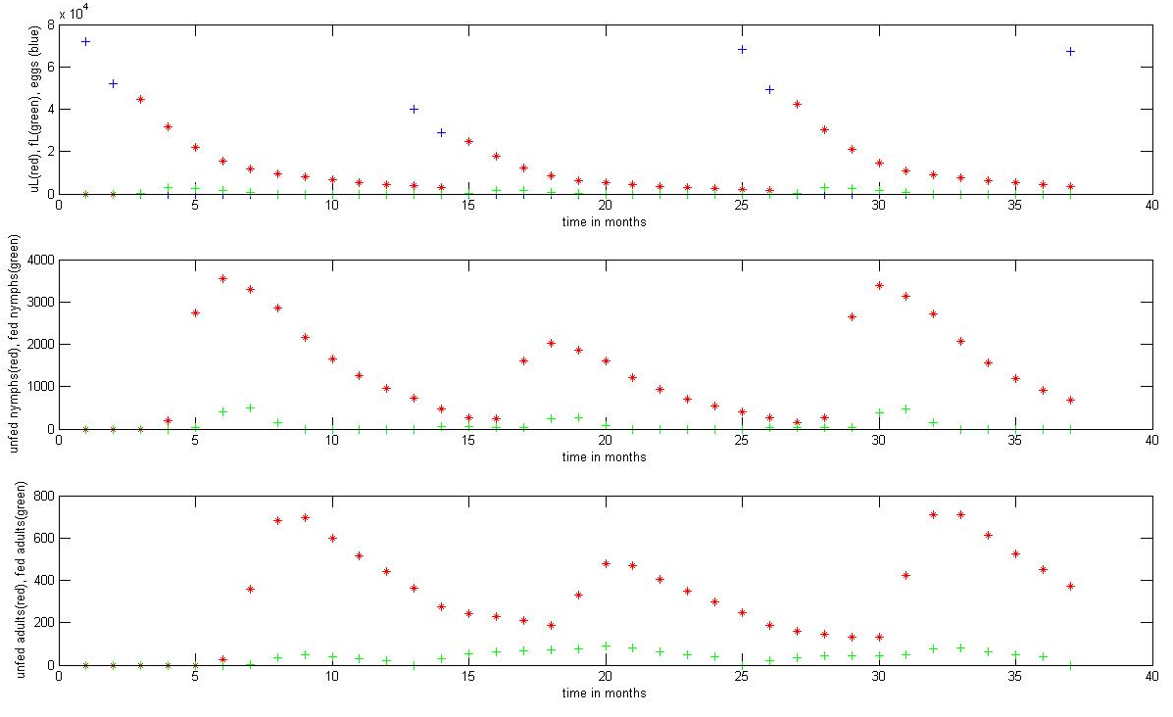
Sample Output
Eggs & Larvae
Nymphs
Adults
Time in months
Notes:
Blue eggs spike at the beginning of each year.
Then, larva, nymphs & adults come out
If eggs do not hatch they die.

Slide 23
Preliminary Spatial Model
Divide FFG into a 10 x 8 grid
Categorize grid squares as ‘Developed’ or ‘Undeveloped’
A tick model runs in each grid square
A specified number of feeders, with a specified layout, are added to the grid
Notes:
Calculate the number of ticks
Economic component – another slide

Slide 24
Feeder position affects on-host tick survival
In each grid square position (i,j):
Area Type affects initial conditions, Developed and Undeveloped.
Feeder proximity affects on-host survival rate (nearby, in square, or none).
RESULT:
(i,j) D | D | 0% U
D | U | 50% U
U | U | 95% U
Notes:
Insert dot for feeder image

Slide 25

Current Feeder Locations
Notes:
Current locations…

Slide 26
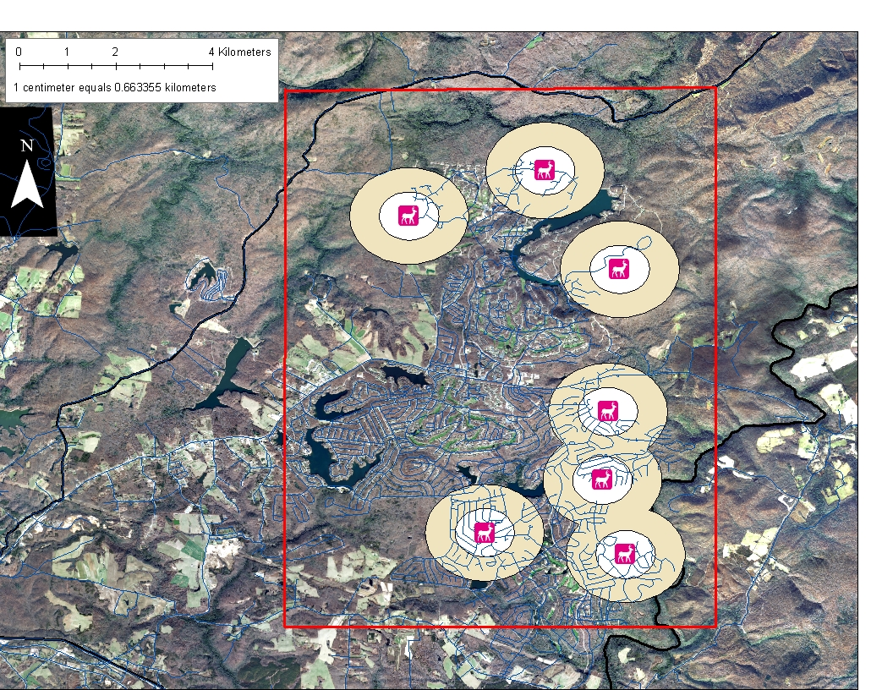
Notes:
How the feeders affect tick abundance
The inner buffer zone is 1 km in diameter and has a 95% tick mortality. The outer buffer zone is 2 km in diameter and has a 50% tick mortality.

Slide 27
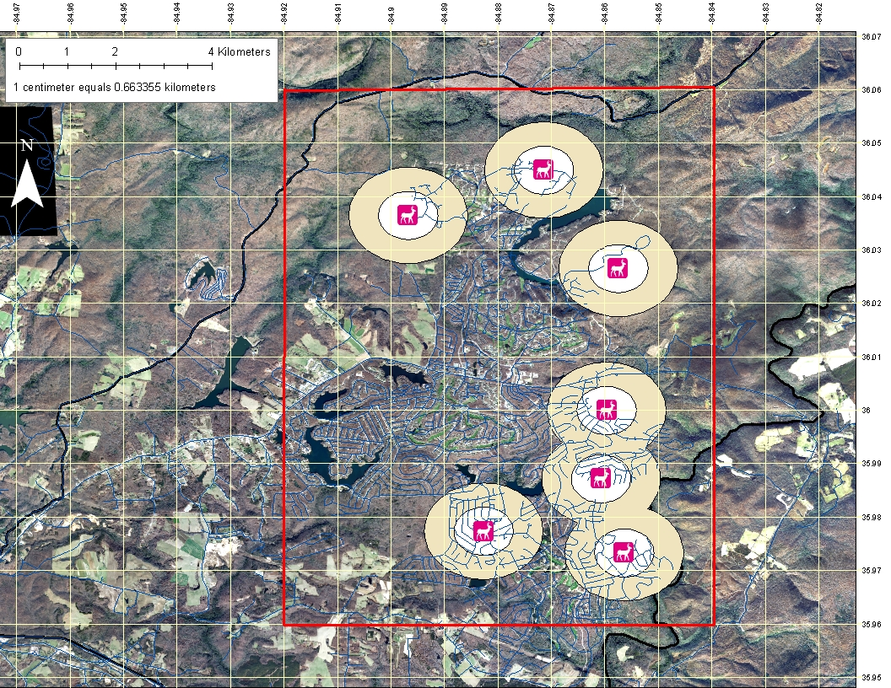
Notes:
0.01 decimal degree grid (36-arc-second)
Approximately 1.1 km square grid
0 = no feeder in area (no reduction)
1 = Feeder in adjacent square (50% reduction)
2 = feeder in area)
(95% reduction)

Slide 28
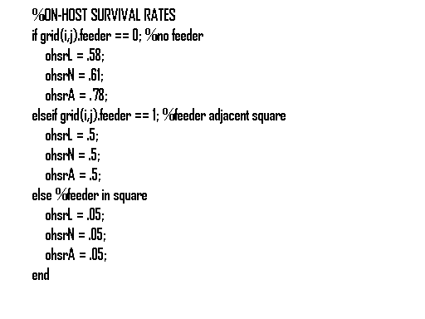
Feeder position affects on-host tick survival
CODE:
Notes:
Insert dot for feeder image

Slide 29
Economic Component
AIM: Choose feeder layout to minimize the expected total cost of disease cases plus the feeder program
  Ehrlichia Treatment = $10,000/case
  Feeder Maintenance = $2,000/year
Example: if 12 feeders reduced ticks by 40% then:
(Base number of cases is 10 per year)
TOTAL COST = (6 cases x $10,000) + (12 feeders x $2000)
= $60,000 disease + $24,000 feeders
= $84,000
Notes:
AIM: Choose feeder layout to minimize the expected total cost of disease cases plus the feeder program
Ehrlichia Treatment = $10,000/case
Feeder Maintenance = $2,000/year
Example: if 12 feeders reduced ticks by 40% then:
(Base number of cases is 10 per year)
TOTAL COST = (6 cases x $10,000) + (12 feeders x $2000)
= $60,000 disease + $24,000 feeders
= $84,000

Slide 30
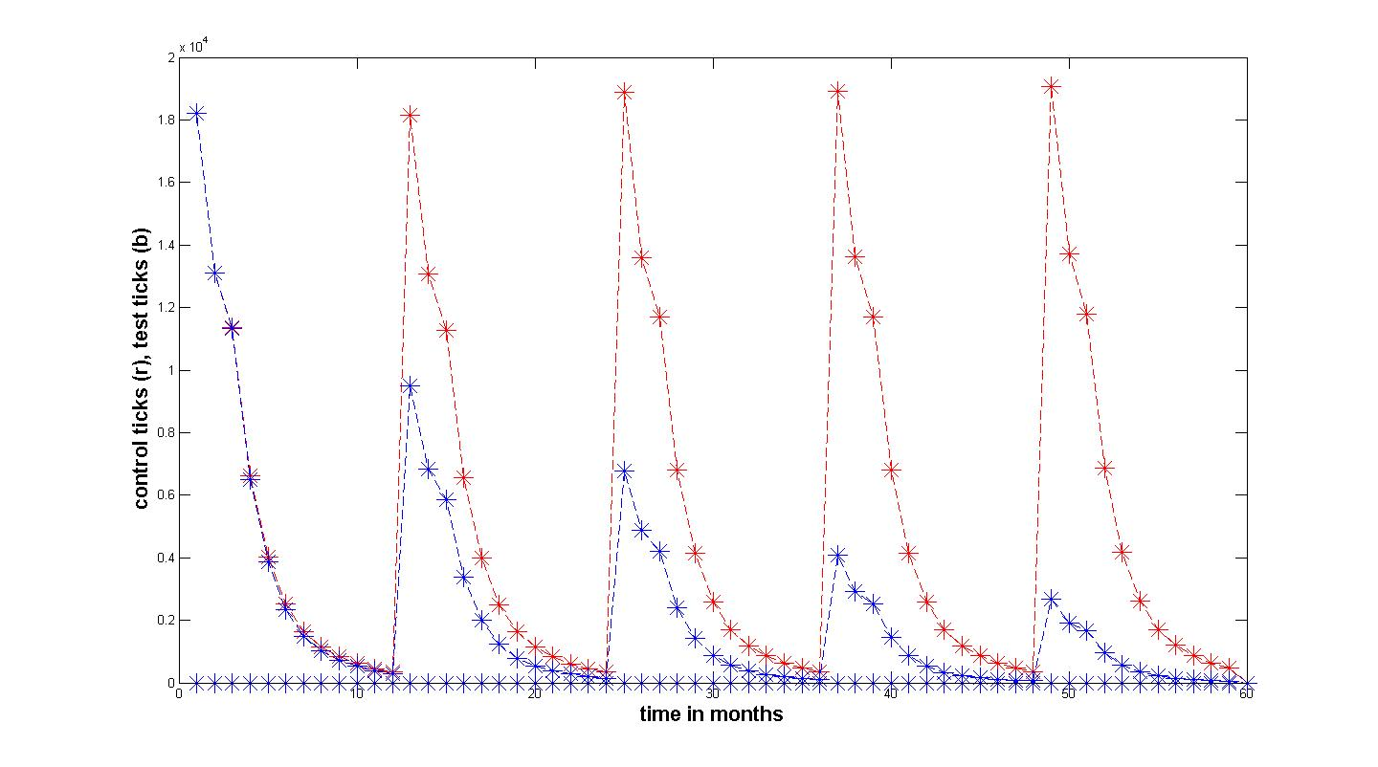
Economic Component
Compare the reduction in tick population achieved in year 4 with current Feeder arrangement to the reduction achieved with a more strategic layout
Year 4 without feeders
Year 4 with feeders

Slide 31
Four Scenarios - Modeled Effect of Feeder Number on %Tick Population
Notes:
8 Feeders
39% reduction
13 Feeders
53% reduction
24 Feeders
62%
Placing a 7 Feeders in Developed/Inhabited area saw a 82% reduction of the tick population in FFG.
Of these 4 scenarios, we considered…

Slide 32
Scenario Analysis
Notes:
8 Feeders
8 * $2,000.00 = $16,000.00
6 cases * $10,000.00 = $60,000.00
Total Cost = $86,000.00
13 Feeders => Best Choice!
13 * $2,000.00 = $26,000 .00
5 cases* $10,000.00 = $50,000.00
Total Cost = $76,000.00
24 Feeders
24 * $2,000.00 = $48,000.00
4 cases * $ 10,000.00 = $40,000.00
Total Cost = $88,000.00

Slide 33
Conclusions (continued)

Slide 34
Conclusions
Practical objective of making tick management suggestions to FFG
First goal was to understand the biology to build a discrete time model
Second goal was to construct a spatial & temporal model to assist with assessing cost-effective efficient layouts for the 4-posters
Reducing tick numbers may help to prevent future Ehrlichiosis outbreaks
Completed a small number of scenario analyses
Aim to investigate the full optimization problem

Slide 35
Conclusions (continued)
Reducing tick numbers may help to prevent future Ehrlichiosis outbreaks
Completed a small number of scenario analyses
Aim to investigate the full optimization problem

Slide 36


Acknowledgements
Dr. Graham Hickling and Suzanne Lenhart
  NIMBioS
Dr. Greg Goins and Thomas Redd NC A&T U.
  NSF UBM Grant # 634598

