Slide 1
Prototeins: A simplified model to study protein folding
Brian Hayes, 1998, American Scientist
Presented by: Chaolun Wang

Slide 2
Protein folding: 1D to 3D
Primary structures of insulin
3D structure of Human Insulin Hexamer
Ultimate goal: predict protein structure based on sequence
Isaiah, 2010, Insulin biosynthesis, secretion, structure, and structure-activity relationships
Chang, X, 1997, Solution structures of the R6 human insulin hexamer

Slide 3
Simplified model: dots and lines on graph paper
Dots: Hydrophobic (H) /Polar (P) amino acid
Lines: The folding structure of Protein on lattice.
Prototein
Brian Hayes, 1998, American Scientist

Slide 4
Method: Self-Avoidance Algorism
Generate all possible sequences of H and P
(such as PHHPPP if number of dots is 6)
2^{r} possibilities for protein of length r
Generate all possible foldings of each sequence:
self-avoiding walk
2.6^{r -1} possibilities for protein of length r
Total possibilities : (2.6^{r -1} ) *(2^{r} )
Brian Hayes, 1998, American Scientist

Slide 5
What makes a lifelike protein?
Have lowest Gibbs free energy
In this case: maximized number of H-H contacts
Good
folding
Random
folding
Brian Hayes, 1998, American Scientist

Slide 6
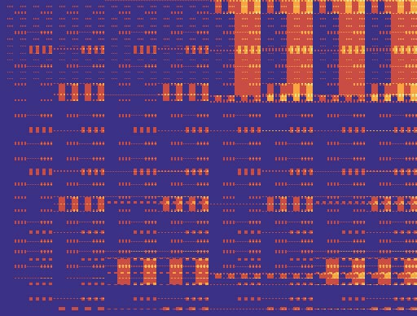
What makes a lifelike protein?
Compact
Have lowest Gibbs free energy
In this case: maximized number of H-H contacts
folding
Spectrum of all possible foldings of nine-bead prototeins
Relaxed
Low H High H
sequence
Brian Hayes, 1998, American Scientist

Slide 7
What makes a lifelike protein?
Stability: Same sequence -> Same structure
In this case: Have a unique best folding
Best folding
Brian Hayes, 1998, American Scientist

Slide 8
Problems to be solved
Modeling protein folding is computationally taxing: :(2.6^{r -1} ) *(2^{r} ) possibilities
Protein length: 20 Possibilities: 20,000,000,000,000
This problem is NP-complete, can only be solved by brute-force computation until now
2. If protein folding is hard how do proteins do it?

