Slide 1
The Britney Spears Problem
Why getting it almost right is OK
and
Why scrambling the data may help
Oops I made it again…

Slide 2
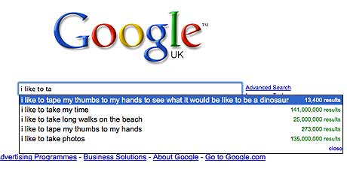
I’m Popular because I’m Popular
With respect to the internet, answering:
Which of these is the most popular web search?
is a much much easier question than answering:
What is the most popular web search?

Slide 3
Straightforward Approach
Let’s assume Google received their engine-search requests via one long data stream that they could read-in in real time…
The straightforward solution would be to append new words to an array containing all words that have already been encountered and update a corresponding counter
…, “Yo dog”, “Girls gone wild”, “Dog ate chocolate”, …
{yo=1, dog=2, girls=1, gone=1, wild=1, ate=1, chocolate=1}

Slide 4
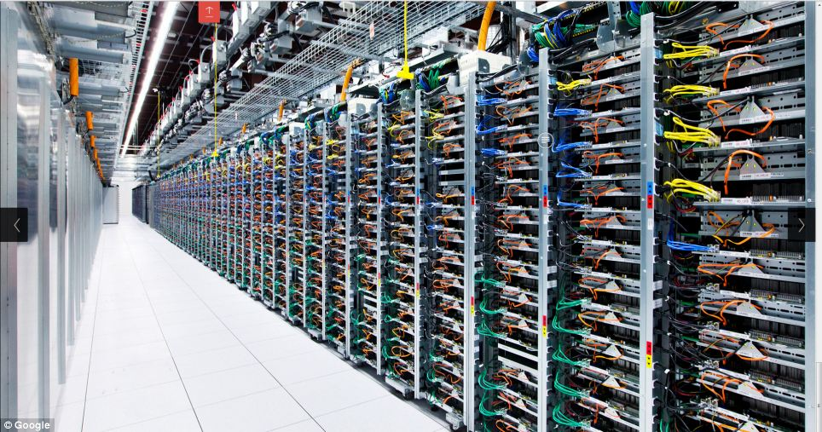
Need for a constant-space algorithm
Deciding whether to append the new word or increment a past counter might require an expensive search through the array
But more importantly, the size of the array would be astronomical with no maximum cap on memory
Image credit: The very Google servers pictured above (trippy right?)

Slide 5
Majority Rule
Imagine if the English language was dumbed down to a few words, or better yet… the integers 1 to 9
Also, assume that one number (let’s say 4) had the majority of the number instances. (This means >50% of the numbers are actually 4)
With the “majority rule” method we would have two pieces of memory:
the most common number up to that point (maj)
a ‘counter’ that we associate with that number (count)

Slide 6
Majority Rule
The rule is that we increment when we stream across the number stored in memory, and decrement otherwise. Example:
… 4
maj=4
count=1
… 4 4
maj=4
count=2
… 2 4 4
maj=4
count=1
… 1 2 4 4
maj=4
count=0
3 1 2 4 4
maj = 3
count=1

Slide 7
Majority Rule
In this case, if 4 had actually been the majority, maj would have =4 when the stream was complete.
Method is guaranteed to find the majority if there is one, but the number stored in memory at algorithm completion is not guaranteed to be a number with >50% of the occurrences
Extend this to use an m number of maj variables to find the n/(m+1) frequency. Example: use m=99 to find if a word appears in 1% of web search queries. Actually pretty robust!

Slide 8
Almost Right
Going back to the original straightforward method of appending to a huge array… what if we just removed the most infrequent elements every once in a while?
This solution gives very good results, but we still have the unbounded space problem.
This (along with Majority Rule) illustrates that we will not get the correct answer 100% of the time if we must obey the constant-space rule.
But is that really all that bad?

Slide 9
Making a Hash
A uniform random distribution actually has expected statistical properties (much like the standard normal distribution)
A method used in computer science called “hashing” essentially bins and scrambles values that come from a unpredictable distribution to make them appear as if they are uniformly distributed.
The bins can then be analyzed statistically to make generalizations about the data stream

Slide 10
Thanks, Britney!
You’ll always be Number 1 in my book, even though the 90’s misses you.
Reference:
Hayes, Brian. “The Britney Spears problem.” American Scientist 96.4 (2008): 274.

